Slide 1
GAN + Landslide Prediction
April 5th 2022
Anran Zheng
Xiaoyi WU

Slide 2
1. Motivation: limited training sample size 2. Solution: GAN 3. Evaluation: AUROC

Slide 3
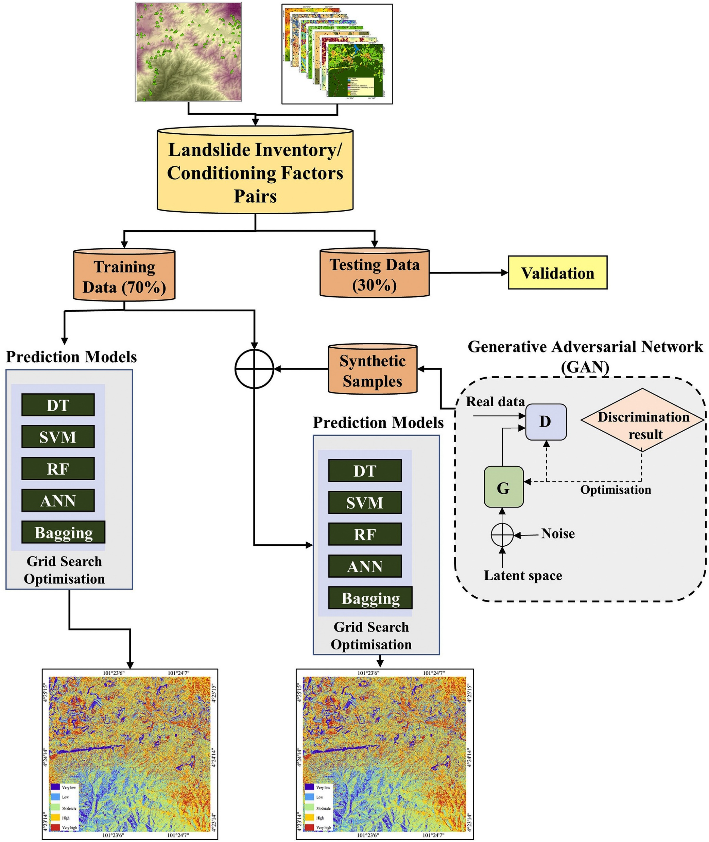
Add synthetic inventory data by GANs and compare the model performance 1. INPUT: landslide inventory of landslide locations and 15 conditioning 2. dataset was split into 70% of training and 30% of testing samples 3. OUTPUT: landslide susceptibility based on ML models

Slide 4
Question 1. Loss function design? ROC is not for Gradient Descent? 2. Only feed data in GAN and say GAN’s performance quite well?

